Slide 1
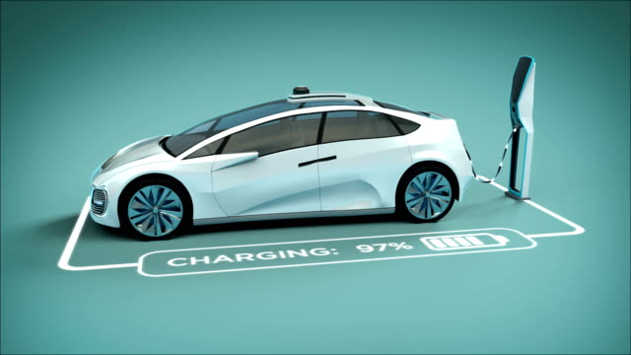
analysis of charging schedules of electric vehicles considering end-user inputs
Presented by :
Arudpiragasam Krisnaragavan - 3105647
Pavan Baragur Sandesh (3105765)

Slide 2
Contents
01
Introduction
02
Data Analysis
03
Problems Statement
04
DLM with Scheduling
05
Benefits
04

Slide 3
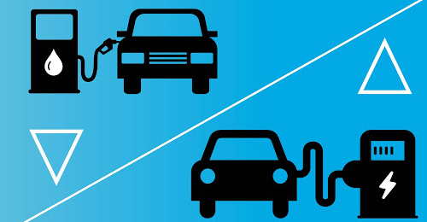
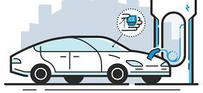
Introduction
IC vs EVs
Necessity of Smart Charging

Slide 4
Factors influencing customer
Orientation of charging station
Availability
Maintenance
Cost

Slide 5
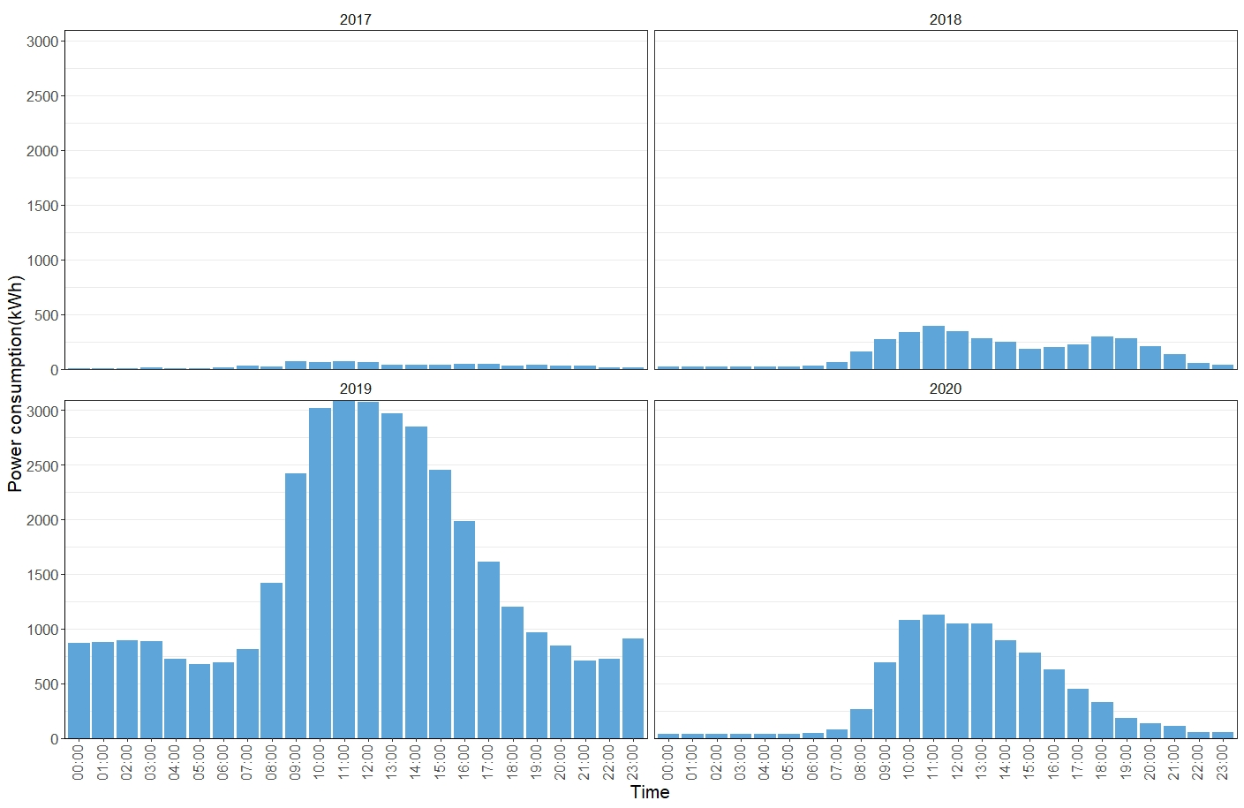
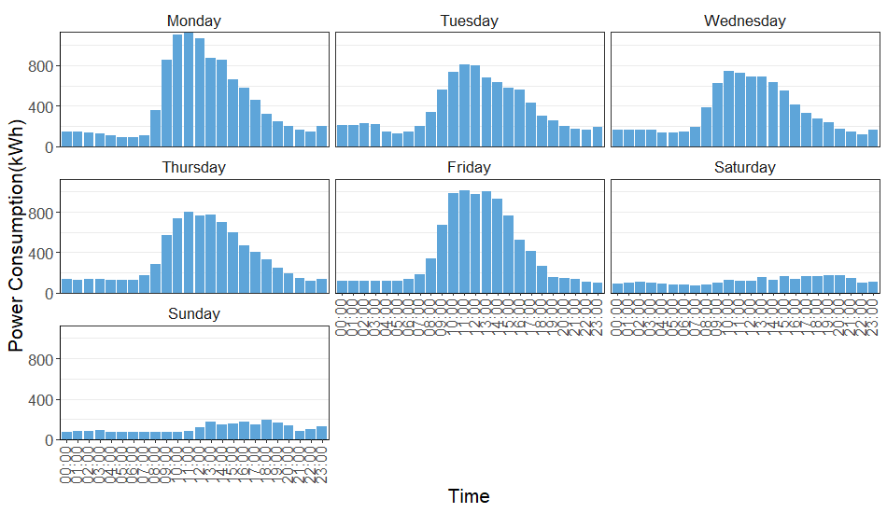
Analysis of power consumption(kWh) for each year
Analysis of power consumption(kWh) for each day
Data Analysis
The peak Power consumption
Monday: 1128.88 kWh
Tuesday: 1011.32 kWh
power consumption peaks range between 8 am and 4 pm

Slide 6
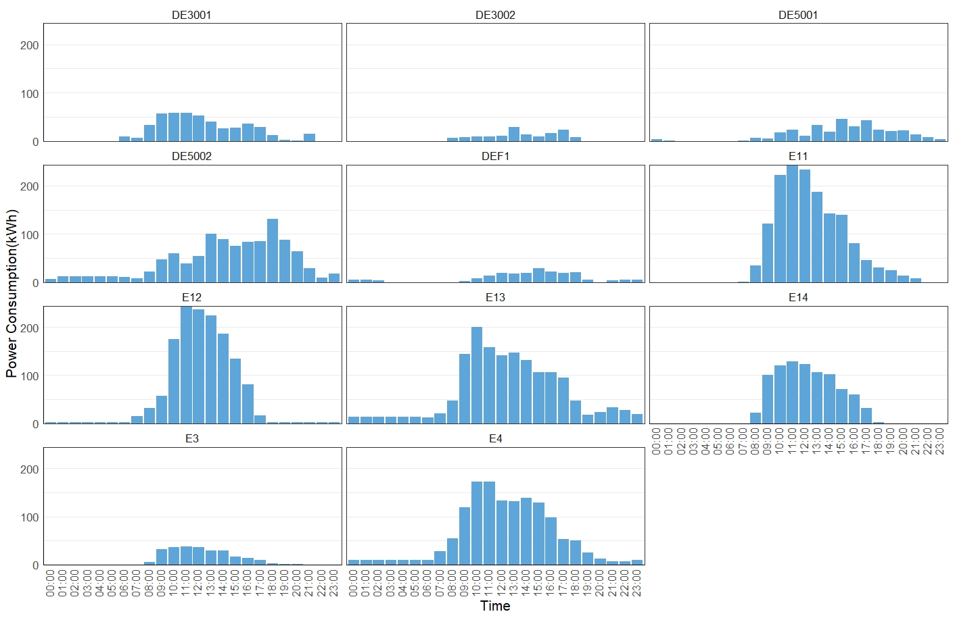
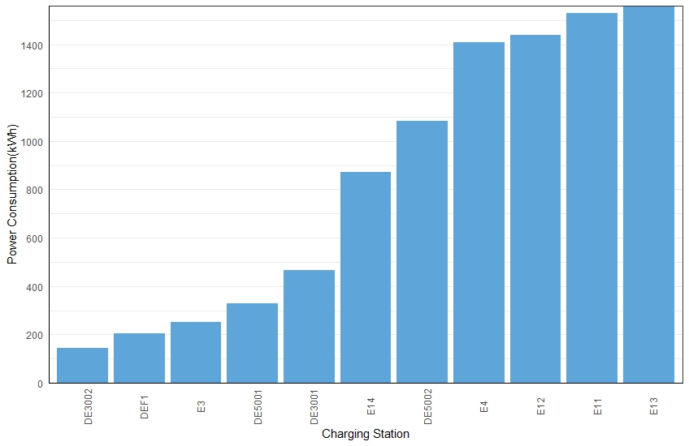
Analysis of Power Consumption for Each Charging Station
Analysis of Total Power Consumption for Each Charging Station
Data Analysis
The stations E12, E11 and E13 are having higher power consumption than the rest of the charging stations

Slide 7
Problem Statements
The stations are overloaded from 8 am to 4 pm and this significantly increases the cost of charging and overburdens the grid
During the working days, the power consumption is higher compared to that of the weekends
The charging stations are not used simultaneously, and each station has different power consumption
Few of the most used stations are active only during working hours and bare a large power consumption in these hours
Few of the stations has minimal power consumptions or some time no power consumption during the non-working hours
Few stations are more popular than most of the stations and are being used regularly

Slide 8
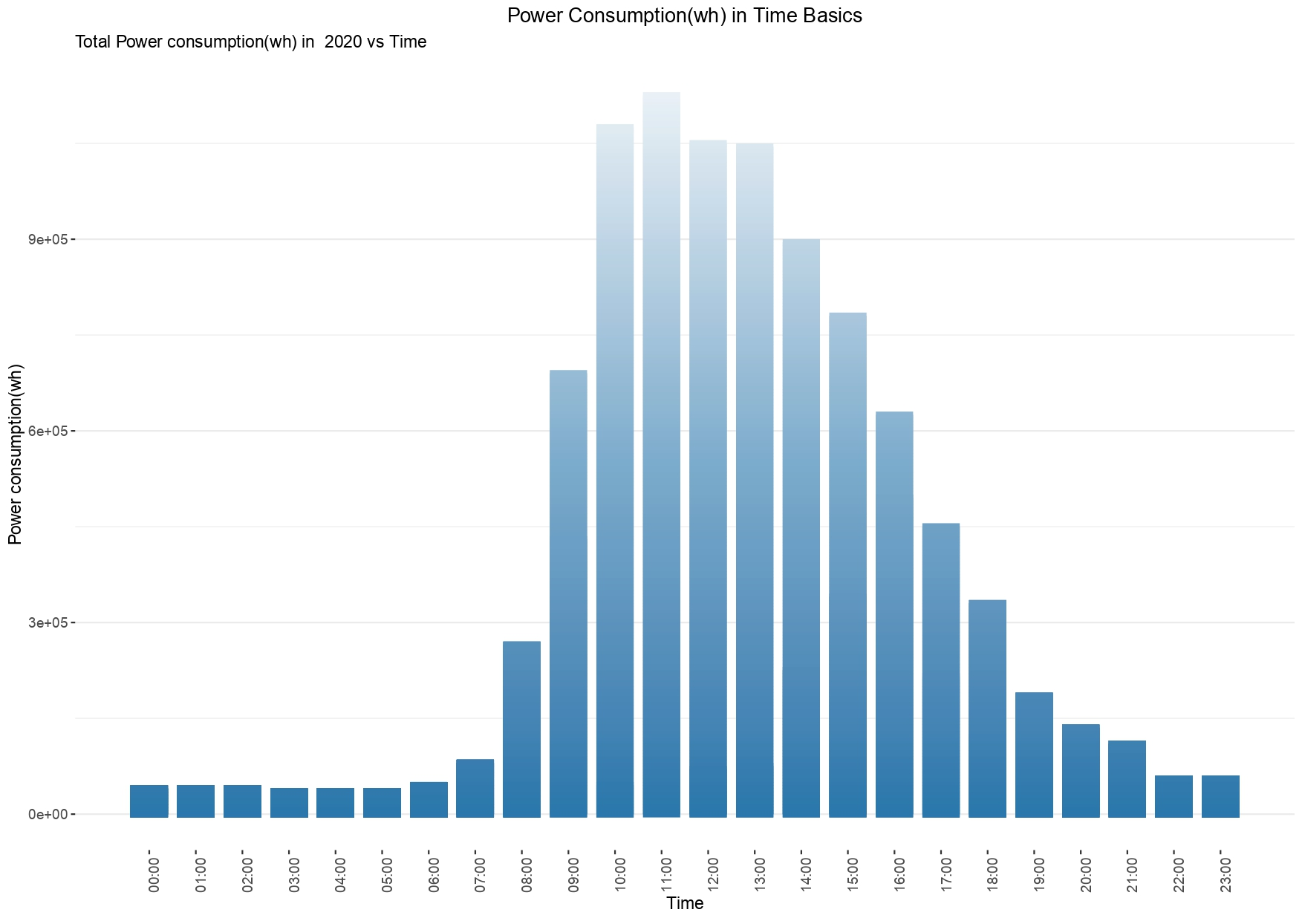
Dynamic Load Management With Scheduling
State-2
State -1: Off-Peak (12 am – 8.59 am)
State -2: Peak (9 am – 4 pm)
State -3: Off-Peak (5 pm – 11.59 pm)
State-1
State-3
Fig: Total Power Consumption vs Time

Slide 9
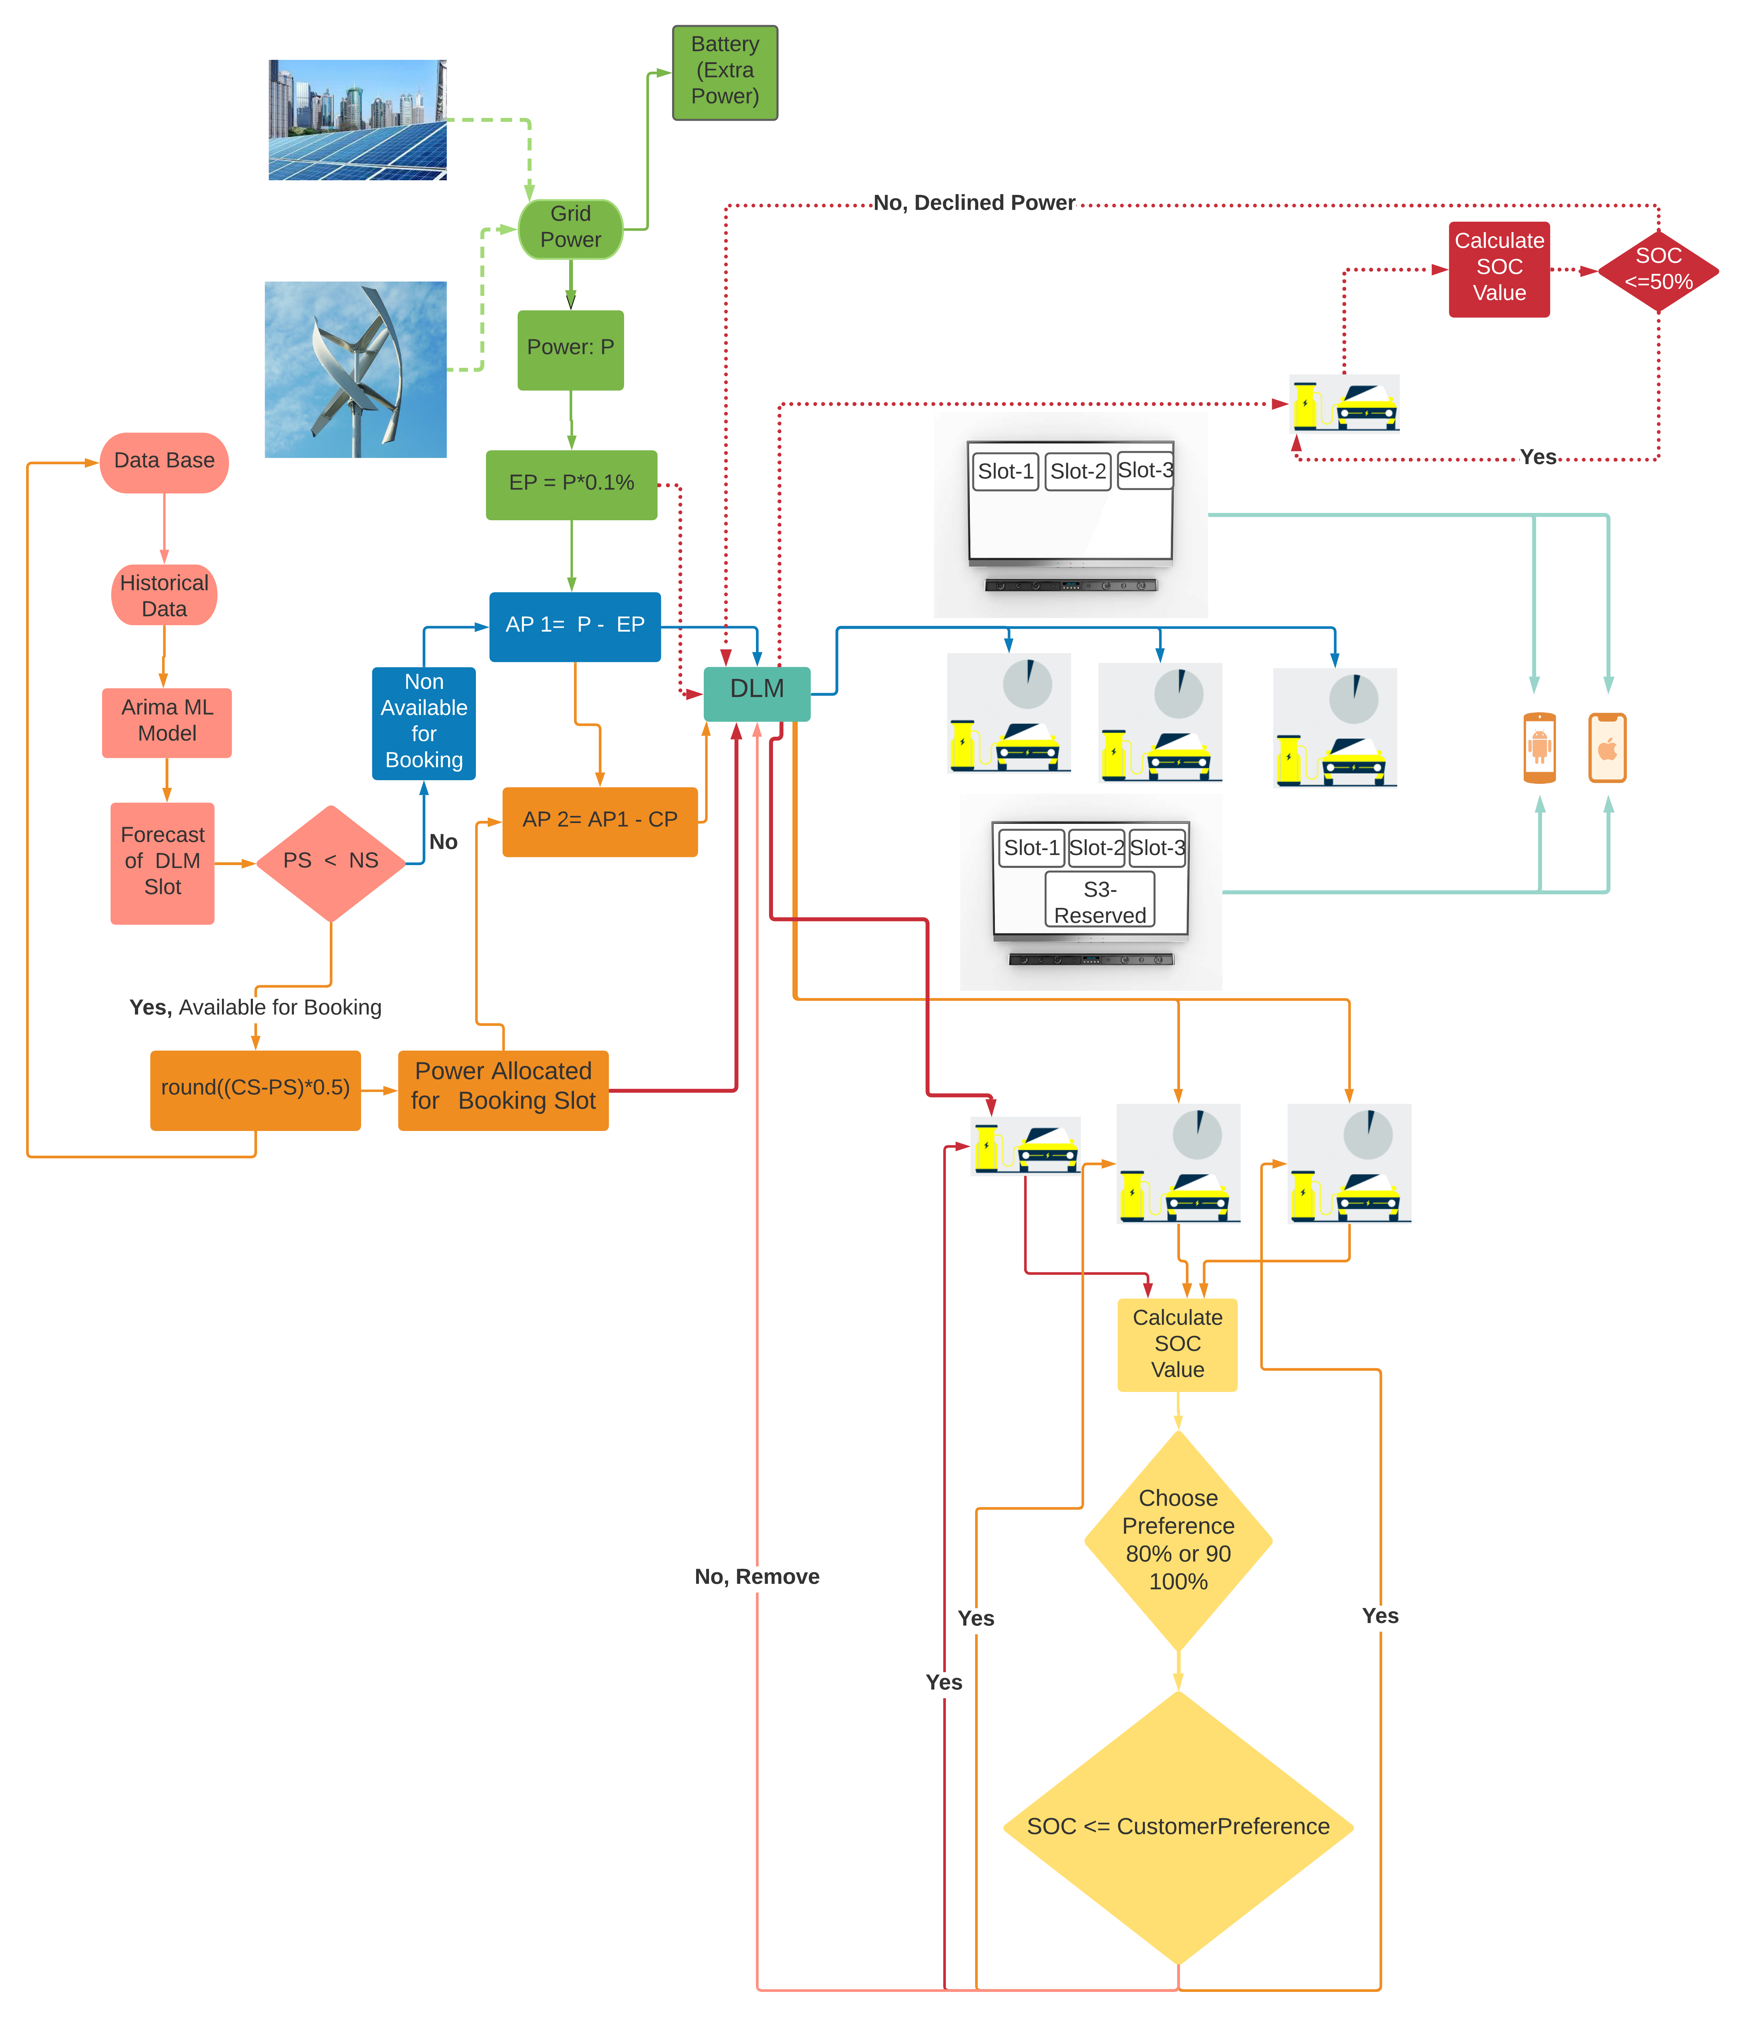
List of abbreviations
Emergency charging Price = 3 * Normal Price
DLM - | Dynamic Load Management
EP - | Emergency Power
PS - | Prediction Slot
NS - | Number of Charging Slot
P - | Peak Power
AP - | Available Power
CP - | Calculated Power
SOC - | State of Charging
Peak Time
Charging Price = 2 * Normal Price
Off-Peak Time
Booking Slot = (CS-PS )*75%
Charging Price = Normal Price
Fig : DLM With Scheduling

Slide 10
Benefits Of DLM With Scheduling Strategy
Prioritizes the vehicles need to be charged based on the EDF (Earliest Deadline First)
This strategy can be implemented in the existing charging stations to avoid any further addition in the infrastructure
The charging costs for customers can be reduced
The electricity costs can be maintained in economical ranges by evenly distributing the power consumption throughout the day hence reducing the peak time costs
Reduces the stress on the grid without overloading the grid by filling the valleys of power consumption
The customer could schedule their EVs according to their priority and Utility owners can benefit by charging higher prices for higher levels of priority

Slide 11
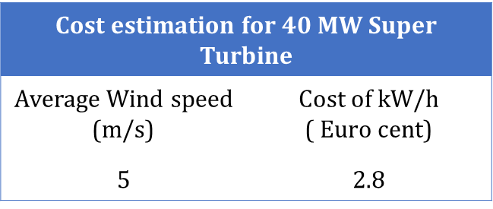
Hybrid Power Cost Estimation
Cost estimation for Solar Panel
Per panel cost ( Euro ) | Rated power ( W ) | Unit Charge ( €/W ) | Cost of Solar panel ( Euro )
24 | 335 | 0.764/watt | 256
Consumer Charging Cost
Battery Size | Charging Time | Cost per kW (€) | Cost to fully charge
24 kWh Battery | 30 min | 0.18/kW | € 4.3
Infrastructure Expenditure
Website and App Cost per Month | Dynamic Load Management Cost Per month | Station Maintenance cost Per month | Parts and Labor cost Per month | Total cost
€ 14 | € 2,500 | € 30,000 | € 50,000 | € 82514

Slide 12
References
Joosung Kang, Scott J. Duncan, Dimitri N. Mavris,” Real-time Scheduling Techniques for Electric Vehicle Charging in Support of Frequency Regulation”, Georgia Institute of Technology, Atlanta, GA,March 19-22, 2013.
Yunjian Xu, Feng Pan, Lang Tong,“Dynamic Scheduling for Charging Electric Vehicles: A Priority Rule”,February 1,2016.
YONGMIN ZHANG,” Dynamic Charging Scheduling for EV Parking Lots With Photovoltaic Power System”,October 1,2018.
Zechun Hu, Kaiqiao Zhan, Hongcai Zhang, Yonghua Song,”Pricing mechanisms design for guiding electric vehicle charging to fill load valley”,2016.
Zhe Yu, Yunjian Xu, and Lang Tong,” Large Scale Charging of Electric Vehicles: A Multi-Armed Bandit Approach”,May 17,2016.

Slide 13


Slide 14


